Slide 1

IoT Based Infrastructure for Remote Sensing and Motor Automation
Students Name- KARTHEESAN K (22BEE1011), NAKUL S (22BEE1246), PRADEESH R (22BEE1268)
Guide Name- Dr. JAMUNA K

Slide 2
Table of Contents
Objectives
Project Overview
Block Diagram
Circuit Diagram
Design Specifications
Analytical Calculations
Simulation
Conclusion
References

Slide 3
Objectives
To develop a predictive maintenance model capable of identifying potential motor faults through machine learning algorithms using Random Forest Regression.
To design a cloud-based communication framework that enables remote speed control of a three-phase induction motor between two different geographical locations using the Google Firebase platform.

Slide 4
Project Overview
Objective 1:
The project implements Machine Learning-based predictive maintenance, using the Random Forest algorithm to detect and classify motor faults.
Broken Rotor Bars
Stator Winding Faults
Ball Bearing Faults
Signal processing techniques like FFT (Fast Fourier Transform) and MCSA (Motor Current Signature Analysis) are used to extract critical fault features.
The trained Random Forest model is evaluated using confusion matrix, accuracy, precision, recall and F1-score to validate its fault prediction capability.
A complete data flow pipeline is designed from cloud-based command transmission to ML-driven fault diagnosis ,entirely implemented in MATLAB for testing and visualization.

Slide 5
Project Overview
Objective 2:
The project focuses on creating a cloud-based predictive maintenance system for a three-phase induction motor, allowing remote monitoring and control across two countries, India and Brazil for our project.
The control signal for the motor is transmitted from two international geographical locations using the Google Firebase platform, demonstrating real-time global connectivity.
The motor control setup includes an ESP32 microcontroller, VFD, and various sensors and the system is currently validated through MATLAB simulations (In future it will be implemented in hardware).
Sensor data such as voltage, current, vibration, temperature and speed is simulated to replicate real-world operating conditions of the motor.
Note: The overall system demonstrates a proof of concept for a cloud-connected, intelligent motor control and maintenance framework, ready for future hardware integration and real-time deployment once physical components are available.

Slide 6
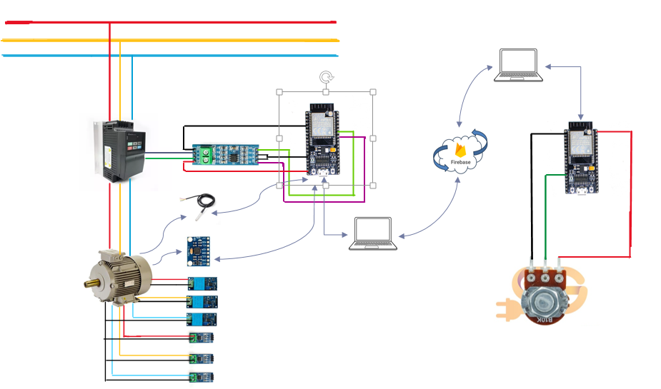
Circuit Diagram

Slide 7
Circuit Diagram
The circuit diagram illustrates a complete system for remotely controlling a 3-phase induction motor .On the load side, the induction motor is powered through the VFD, which modulates the voltage and frequency to control motor speed and torque.
The VFD receives control signals via RS485, which are generated by the load-side .
On the controller side, a separate microcontroller generates commands such as motor speed, Start and stop instruction. These commands are communicated to the load side via Firebase cloud services, enabling real-time remote control.
The cloud acts as a bidirectional communication bridge, allowing the controller to send commands and receive feedback on motor performance or faults.
Feedback signals from the motor travel back through the same path in reverse, ensuring that the controller side is continuously updated.
The main target is to include real-time remote operation and a reliable communication interface. Two-way data flow ensures that control and monitoring occur simultaneously.

Slide 8
Circuit Diagram
The system uses vibration, temperature, voltage and current sensors to monitor real-time operating conditions of the 3-phase induction motor. These sensors capture essential performance parameters required for fault detection and analysis.
The collected sensor readings help identify variations motor temperature, unusual vibrations, voltage and current faults. These parameters form the base data for both monitoring and training the ML model.
The live sensor data is transferred to Google Sheets through the cloud interface, where it is compared with ML-predicted outputs to verify accuracy. This continuous data transfer and comparison help validate the model’s reliability and improve prediction performance

Slide 9
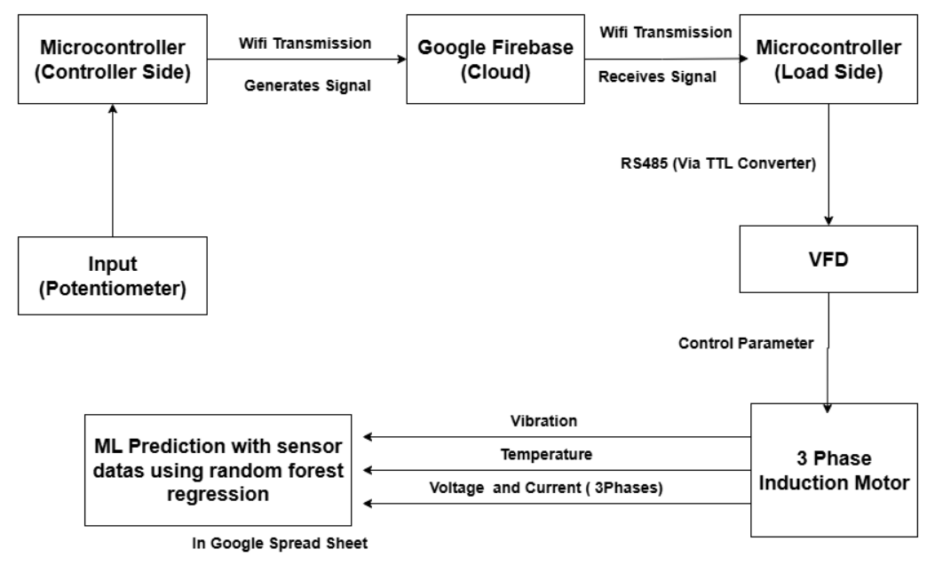
Block Diagram

Slide 10
Block diagram
Sensor data collection- Sensors continuously measure voltage, current, temperature, and vibration parameters of the motor. These signals act as the primary input for the ML-based monitoring system.
Data preprocessing- Collected data is filtered and normalized to remove noise and stabilize readings. This ensures accurate input to the prediction model without distortion.
Feature Extraction- Key features such as RMS current, torque variation, and thermal response are extracted from the raw sensor data. These features help identify motor performance and operating trends.
A trained ML model analyzes input patterns to detect early signs of faults like overcurrent or overheating. This supports predictive maintenance and prevents breakdowns. This is done to see the fault parameters
The ML system dynamically adjusts operating parameters to maintain optimal voltage-frequency ratio. This enhances efficiency and smooth torque output under variable load.

Slide 11
Block Diagram
The model monitors data in real time and issues alerts for unusual behavior. This allows timely corrective actions and improves system reliability.
The controller section is planned to handle command signals such as start, stop, and speed control. It acts as an interface between ML output and the motor drive system.
Firebase-based cloud setup will ensure remote data transfer between the ML system and controller. It will enable two-way monitoring and command execution.
The Variable Frequency Drive receives control signals to regulate voltage and frequency. This allows speed and torque control based on predicted ML recommendations.
Once hardware integration is complete, feedback signals from sensors will be continuously analyzed. This ensures accurate synchronization between predicted and actual motor performance.

Slide 12
Design Specifications
Motor (Target) & VFD (Target) Specifications | • Model: Siemens IE2 Category Motor • Power: One HP/0.75 kW • Voltage: 415 V, 50 Hz • Speed: 1000 RPM • Foot mounting, 6-pole, VPI insulation • Model: Delta VFD007EL43W ELW • Power: One HP/0.75 kW & 3-phase output • Controls speed by varying voltage & frequency. • Communication: RS485 (Modbus RTU)
Communication Protocols | Cloud link: Firebase Realtime Database for low-latency publish/subscribe. Local link: TTL to RS485 (Modbus RTU or custom serial) between ESP32 and VFD. Telemetry push: ESP32 to Google Sheets API or Firebase; design includes JSON payload format and timestamps (UTC).
Sensors for ML Prediction | ZMPT101B (Voltage), DS18B20 (Temp), ACS712 (Current), MPU-6050 (Gyroscope), TTL-RS485 (Later)

Slide 13
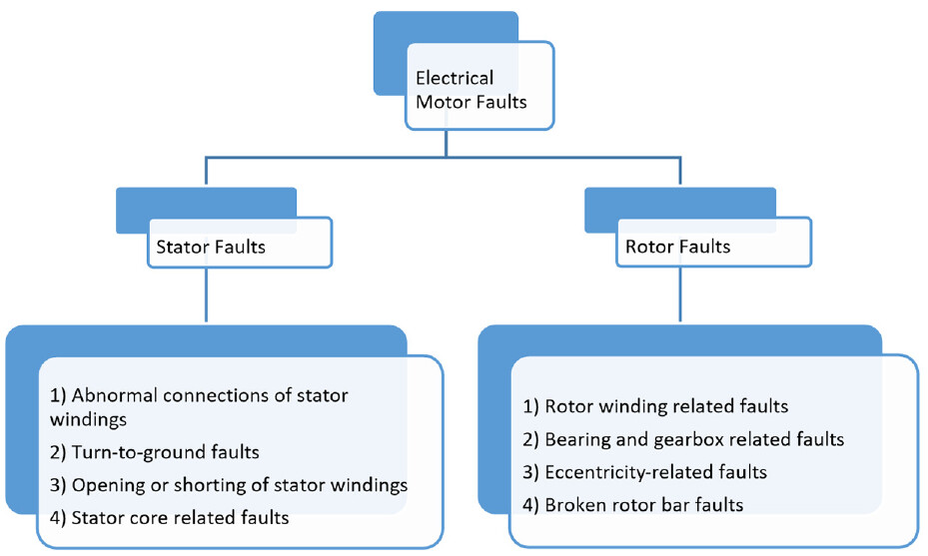
Analysis

Slide 14
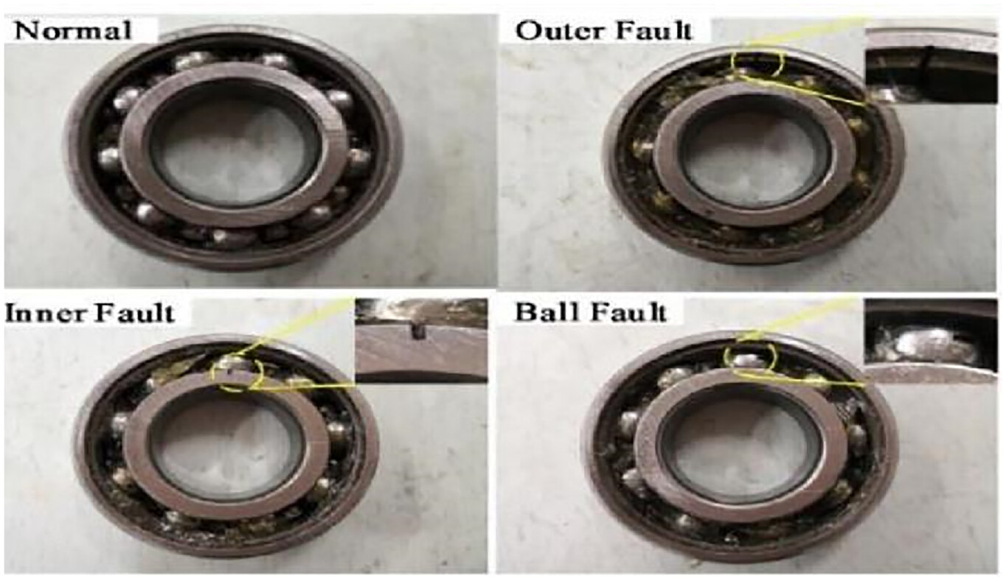
Analysis

Slide 15
Analysis
Feature | What It Detects
Temperature Mean/Peak | Overheating, cooling system failure, overload
Temperature Std/Skewness | Unstable operation, intermittent faults
Vibration Mean/RMS | Bearing wear, misalignment, rotor imbalance
Vibration Peak | Mechanical shocks, loose parts
Voltage Imbalance | Supply problems, phase loss, winding issues
Current Imbalance | Rotor bar cracks, stator winding faults
Kurtosis | Impulsive events (bearing spalls, tooth cracks)

Slide 16
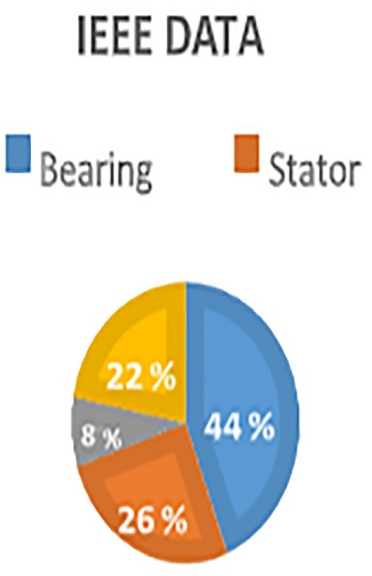
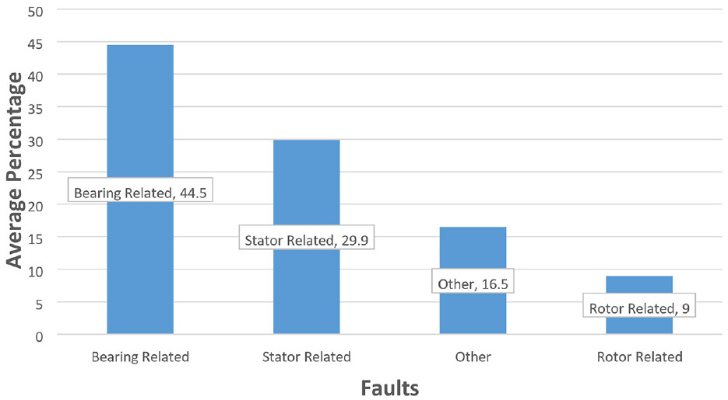
Analysis

Slide 17
Analysis
Mean (Average): The mean represents the central tendency of the signal and provides a baseline reference for the sensor measurements. For temperature data, the mean indicates the average operating temperature of the motor.
μ = (1/n) Σ xi
Statistical Features
Standard Deviation: Standard deviation quantifies the amount of variation or dispersion in the sensor measurements. Higher standard deviation indicates greater variability, which may signal abnormal operating conditions or incipient faults.
σ = √[(1/n) Σ(xi - μ)²]
Root Mean Square (RMS): RMS value represents the effective magnitude of a signal and is particularly useful for analyzing alternating current and vibration signals. It provides a measure of the signal's energy content.
RMS = √[(1/n) Σ x_i²]

Slide 18
Analysis
Kurtosis: Kurtosis measures the "tailedness" of the probability distribution and is sensitive to outliers and transient events. It is particularly useful for detecting bearing faults and other impulsive anomalies.
Kurtosis = 3: Normal distribution (Gaussian)
Kurtosis > 3: Heavy tails, indicating presence of extreme values or spikes
Kurtosis < 3: Light tails, indicating a more uniform distribution
Skewness: Skewness measures the asymmetry of the probability distribution. It indicates whether the data is skewed toward higher or lower values relative to the mean.
Skewness = 0: Symmetric distribution (balanced)
Skewness < 0: Left-skewed (tail extends toward lower values)
Skewness > 0: Right-skewed (tail extends toward higher values)

Slide 19
Analysis
Bearing Characteristic Frequencies:
N_b = Number of balls or rollers in the bearing
d = Ball diameter (mm)
D = Pitch diameter (mm)
α = Contact angle (degrees)
f_s = Shaft rotation frequency (Hz)
Ball Pass Frequency Outer Race (BPFO):
f_BPFO = (N_b × f_s / 2) × (1 - (d/D) × cos(α))
This frequency represents the rate at which rolling elements pass over a defect on the outer race of the bearing.
Ball Pass Frequency Inner Race (BPFI):
f_BPFI = (N_b × f_s / 2) × (1 + (d/D) × cos(α))
This frequency represents the rate at which rolling elements pass over a defect on the inner race.

Slide 20
Analysis
Ball Spin Frequency (BSF):
f_BSF = (D × f_s / 2d) × [1 - ((d/D) × cos(α))²]
This frequency corresponds to the rotation of the rolling elements themselves.
Fundamental Train Frequency (FTF) or Cage Frequency:
f_FTF = (f_s / 2) × (1 - (d/D) × cos(α))

Slide 21
Analysis
Motor Current Signature Analysis (MCSA): It is a non-invasive diagnostic technique that analyzes the frequency spectrum of motor current to detect various types of faults. MCSA is particularly effective because motor faults introduce characteristic frequency components in the current signal that can be detected using FFT.
Stator Winding Faults: Stator winding faults include inter-turn short circuits and phase imbalances that produces harmonics at the following frequencies. f_stator = f_s × (1 ± 2k)
These faults create harmonics at 150 Hz, 250 Hz, and other frequencies with abnormally high amplitudes compared to a healthy motor.

Slide 22
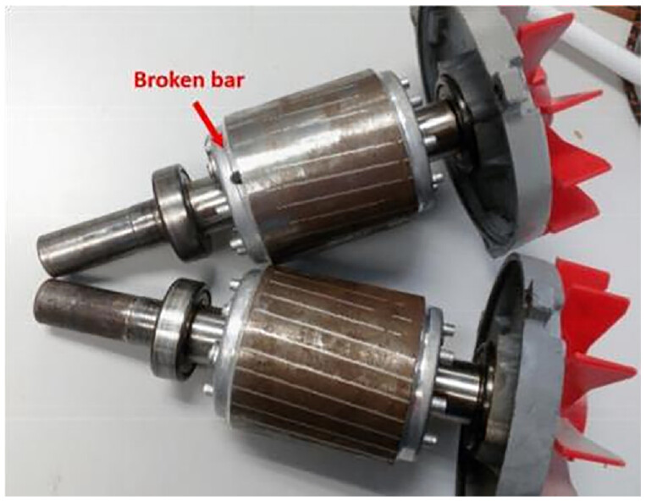
Analysis

Slide 23
Analysis
Broken Rotor Bar Fault: Broken rotor bars are among the most common motor faults and can be detected using MCSA. The fault introduces sidebands around the supply frequency at specific frequencies determined by the motor slip.
f_brb = f_s × (1 ± 2ks)
Where:
f_s = Supply frequency (50 Hz)
k = Harmonic order (1, 2, 3, ...)
s = Motor slip
For the Siemens motor used in this project (0.75 kW, 1 HP, 6-pole, 415V, 50Hz, 3-phase, 1000 rpm synchronous speed, 970 rpm actual speed), the slip is calculated as:
s = (N_s - N_r) / N_s = (1000 - 970) / 1000 = 0.03 = 3%
Therefore, the broken rotor bar fault frequencies are:
f_brb = 50 × (1 ± 2 × 1 × 0.03) = 50 ± 3 = 47 Hz and 53 Hz
The presence of significant peaks at 47 Hz and 53 Hz in the current spectrum indicates a broken rotor bar condition.

Slide 24
Analysis
TP (True Positive)
Definition: The model correctly predicted a positive class when it actually was positive​
Motor Example: Model predicts "Warning" and the motor status is actually "Warning"
Formula position: Diagonal of confusion matrix (correct prediction)
TN (True Negative)
Definition: The model correctly predicted a negative class when it actually was negative​
Motor Example: Model predicts "Normal" and the motor status is actually "Normal"
Formula position: Diagonal of confusion matrix (correct prediction)
FP (False Positive) - Type I Error
Definition: The model incorrectly predicted positive when it should have been negative​
Motor Example: Model predicts "Critical" but the motor is actually "Normal"
Impact: False alarm - unnecessary maintenance, wasted resources
Also called: Type I error, false alarm​
FN (False Negative) - Type II Error
Definition: The model incorrectly predicted negative when it should have been positive​
Motor Example: Model predicts "Normal" but the motor is actually "Critical"
Impact: Most dangerous - missed failure, potential catastrophic breakdown
Also called: Type II error, miss

Slide 25
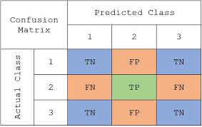
Analysis
CONFUSION MATRIX:

Slide 26
Analysis
Accuracy: The proportion of correct predictions among all predictions. It is calculated as:
Accuracy = (Total Correct Predictions) / (Total Predictions)
While accuracy is intuitive, it can be misleading for imbalanced datasets where one class significantly outnumbers others.
Precision: The proportion of true positive predictions among all positive predictions for a specific class. High precision indicates that when the model predicts a particular class, it is usually correct.
Precision = True Positives / (True Positives + False Positives)
Recall (Sensitivity): The proportion of true positive predictions among all actual instances of a class. High recall indicates that the model successfully identifies most instances of the class.
Recall = True Positives / (True Positives + False Negatives)

Slide 27
Analysis
F1 Score: The harmonic mean of precision and recall, providing a balanced measure that accounts for both false positives and false negatives.
F1 = 2 × (Precision × Recall) / (Precision + Recall)
In predictive maintenance applications, recall is often prioritized for the "Critical" class because failing to detect a critical fault can lead to catastrophic failures and safety hazards. Conversely, precision is important for the "Warning" class to avoid unnecessary maintenance activities that increase operational costs.

Slide 28
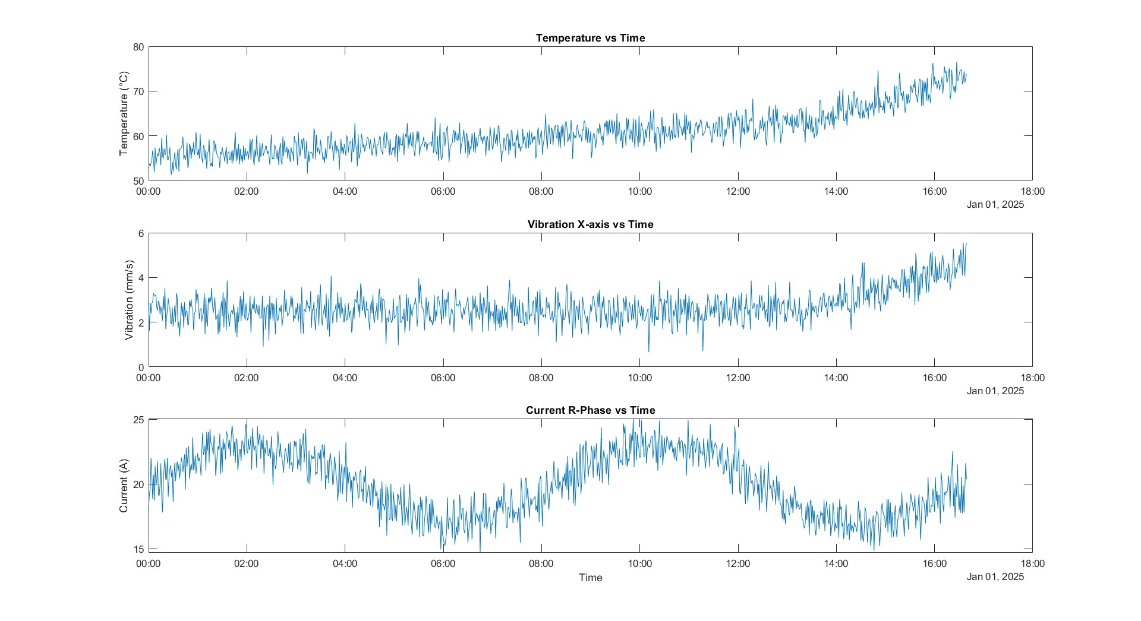
Simulation

Slide 29
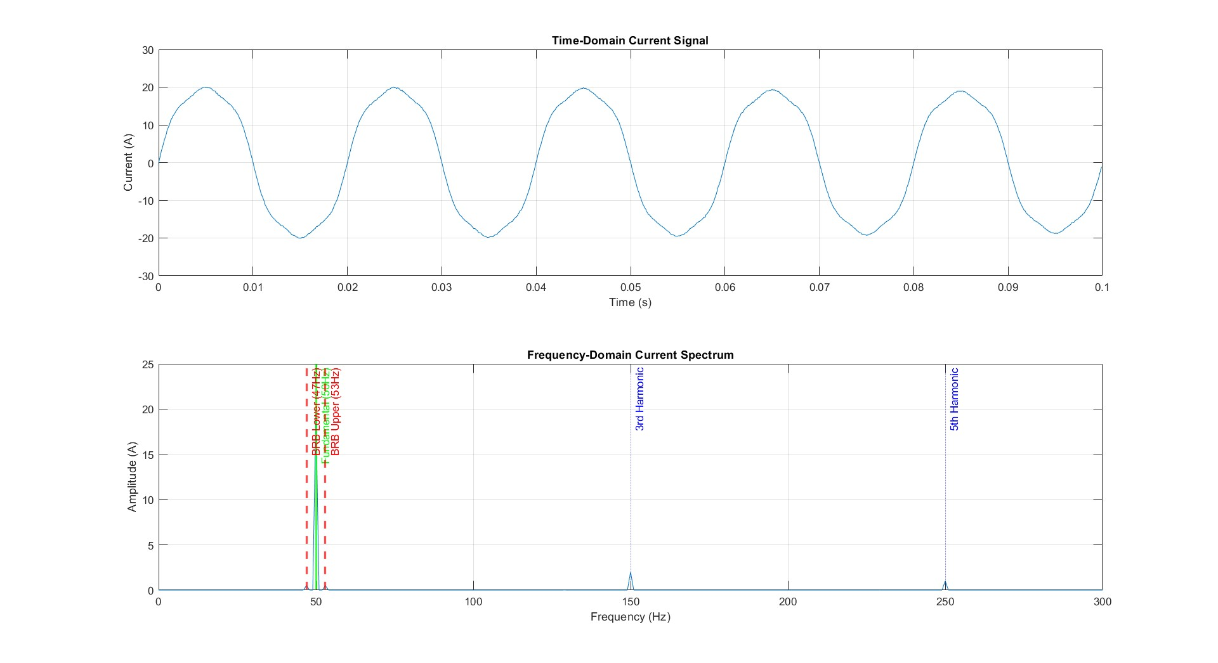
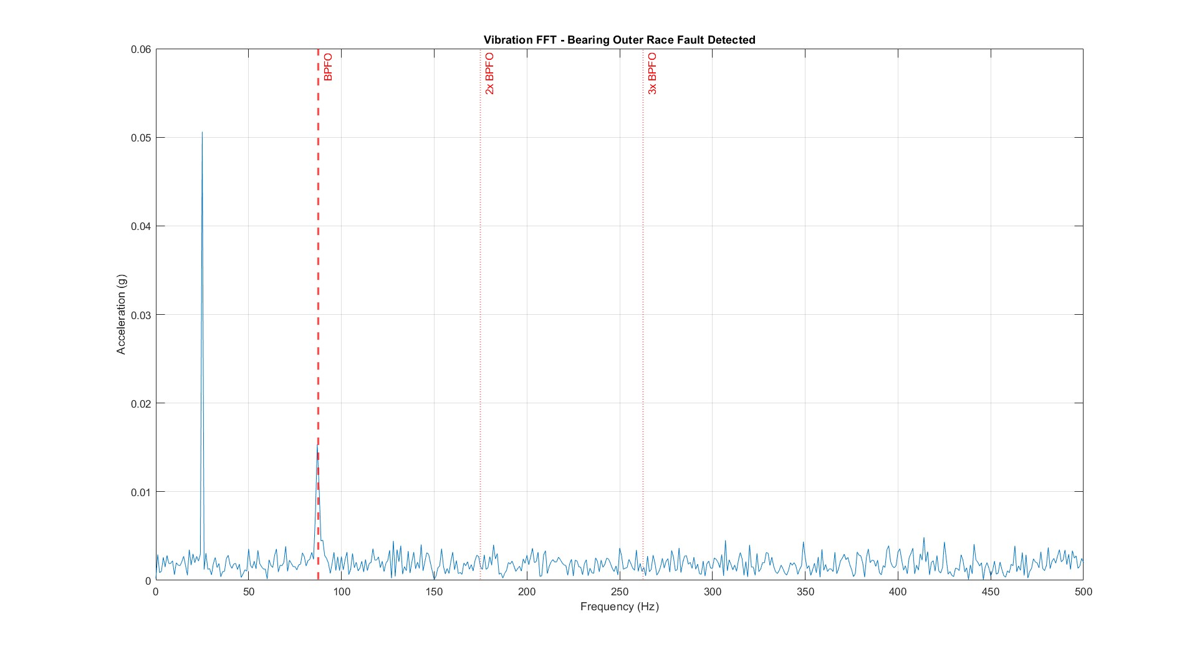
Simulation

Slide 30
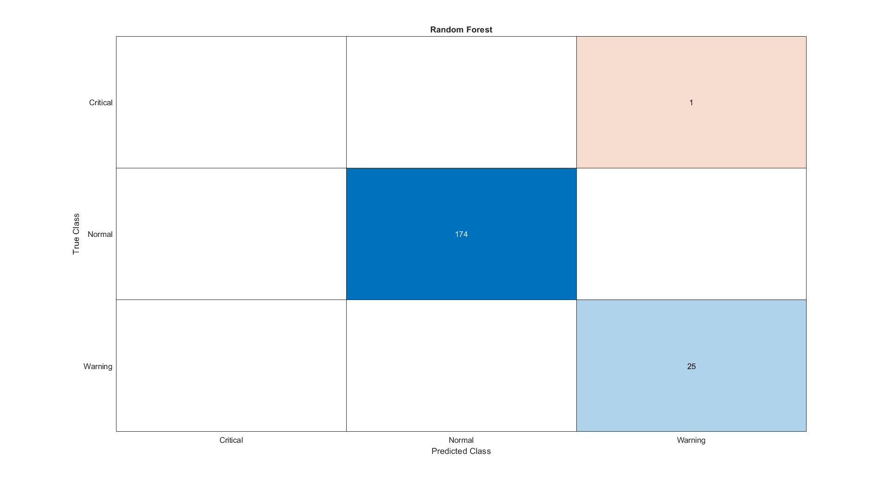
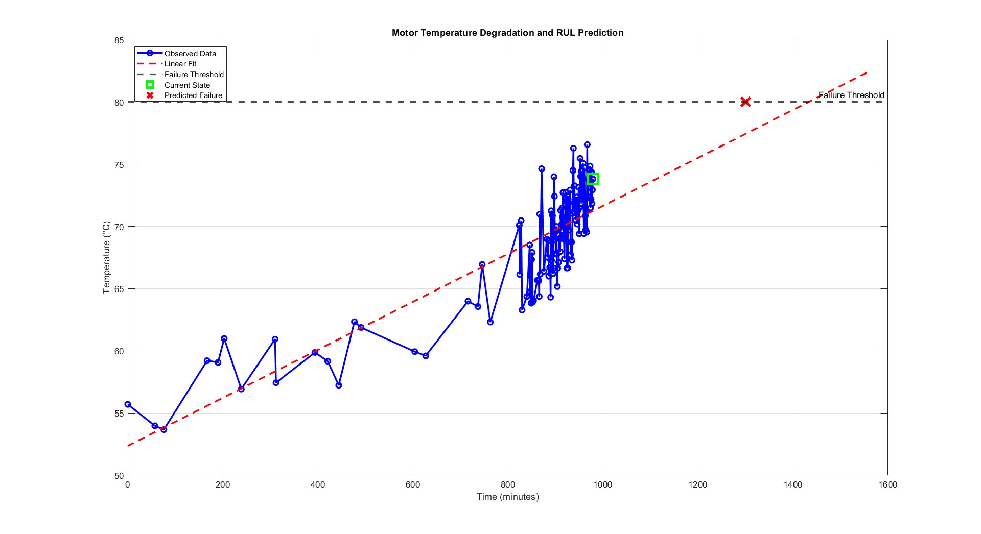
Simulation

Slide 31
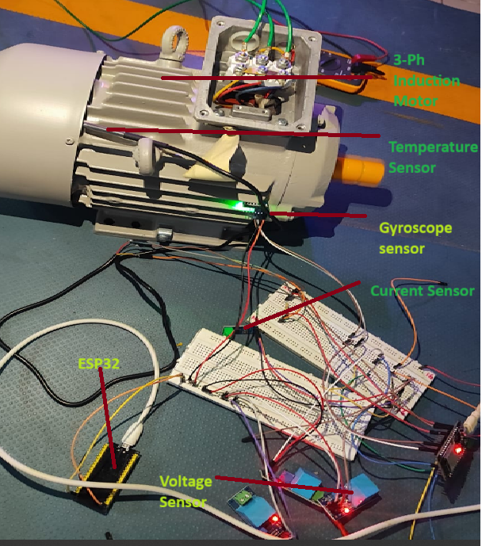
Hardware

Slide 32
Conclusions
Predictive maintenance framework can detect motor faults before downtime.
Random Forest model achieves high accuracy in classifying motor conditions.
Vibration, current and temperature features are key fault indicators.
FFT and MCSA effectively identify rotor and stator faults.
Vibration analysis detects bearing faults through characteristic frequencies.
Cloud-based signal transmission enables remote motor control readiness.
System is scalable and adaptable for future real-time industrial deployment.

Slide 33
Publications
Patent application has been submitted to Khurana & Khurana IP Attorneys for novelty verification.
Nakul S, Pradeesh R, Jamuna Kamaraj, Marconi Januário, “Application of the Fiirebase Platform for Power Quality Data Management in an IOT System”, in Seminar on Scientific Initiation, Extension, and Research, XVIIISIEPE, 1 Page, Oct 2025, Jocaba, Brazil.

Slide 34
References
[1] MathWorks (2024). "Predictive Maintenance Toolbox - MATLAB." MathWorks Documentation.
[2] Graves, R. (2021). "Predictive Maintenance with MATLAB: A Data-Based Approach." MathWorks Webinar Series.
[3] Wu, M. et al. (2024). "An intelligent predictive maintenance system based on random forest for addressing industrial conveyor belt challenges." Frontiers in Mechanical Engineering, Vol. 10.
[4] Ali, U. (2009). "Towards Fault Diagnosis in Induction Motor using Fractional Fourier Transform." arXiv preprint.
[5] Allal, A. et al. (2022). "Diagnosis of induction motor faults using the motor current signature analysis and fast Fourier transform." International Journal of Electrical Power & Energy Systems, Vol. 142.
[6] Wang, Z. et al. (2011). "Online fault detection of induction motors using frequency domain independent component analysis." IEEE Transactions on Industrial Electronics.

Slide 35
Thank You
Kartheesan K, Nakul S, Pradeesh R

